Slide 1

Paint With Sound
Team 330 /
Jingwei Fan (jingweif)
Jing Xu (jxu2)
Sprint 1 presentation

Slide 2
Application Goal & Design
Transform sound into images.
Light-weighted social function(Not our focus!).
Three modes
Real-time image generation according to microphone input
More complicated & styled image generated from user-uploaded audio file
Image selection combining simple speech analysis

Slide 3
Path for Mode1 Implementation
Straight-forward 2-phase thinking
Extract data from audio input
Generate image using the extracted data
Real-time feedback
No complicated calculation, the generated images are relatively simple
Focus mainly on front-end
Utilize JS library to achieve our goal
Web Audio API – record microphone input and extract data
D3.js – Visualize data and display

Slide 4
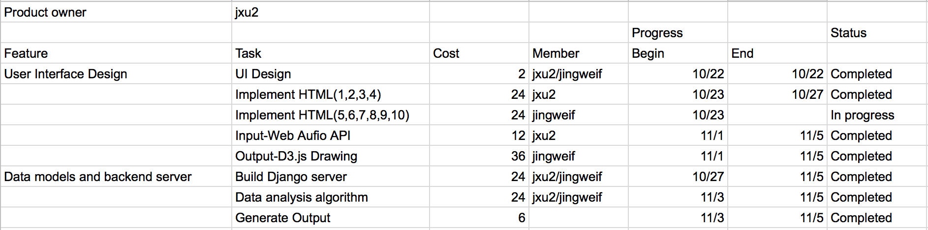
Sprint 1

Slide 5
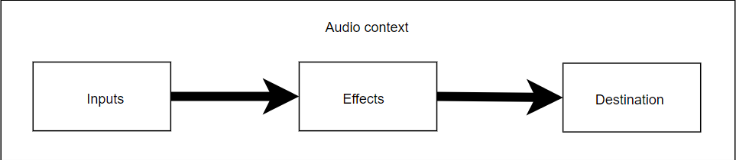
Sound to Data: Web Audio API
Audio Routing Graph
Audio operations are handling inside an audio context
Basic audio operations are performed with audio nodes
Audio nodes are linked to form a audio routing graph

Slide 6
Sound to Data: Web Audio API
Source of the ARG: audio stream input through microphone
Destination of the ARG: currently output device (will be saved to server)
User analyserNode to extract data
Current frequency data of the audio stream
Current waveform, or time-domain data, of the audio stream
Use convolverNode to create more audio data
Conduct a convolution on the original audio stream, then grab the frequency and the waveform data of the processed audio stream.

Slide 7
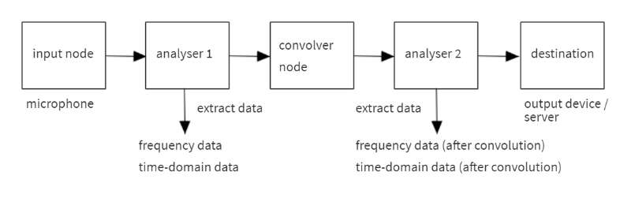
Sound to Data: Web Audio API

Slide 8
Data to Image: D3.js
Data Virtualization
“D3.js is a JavaScript library for manipulating documents based on data. D3 helps you bring data to life using HTML, SVG, and CSS. ”
HTML5 :
CANVAS (2D Bitmap):
SVG (Scalable Vector Graphics):

Slide 9
Data to Image: D3.js
Animation:
Stack
Streamgraph
D3.transmition()
D3. duration()
D3.ease()
D3.delay()
…

Slide 10
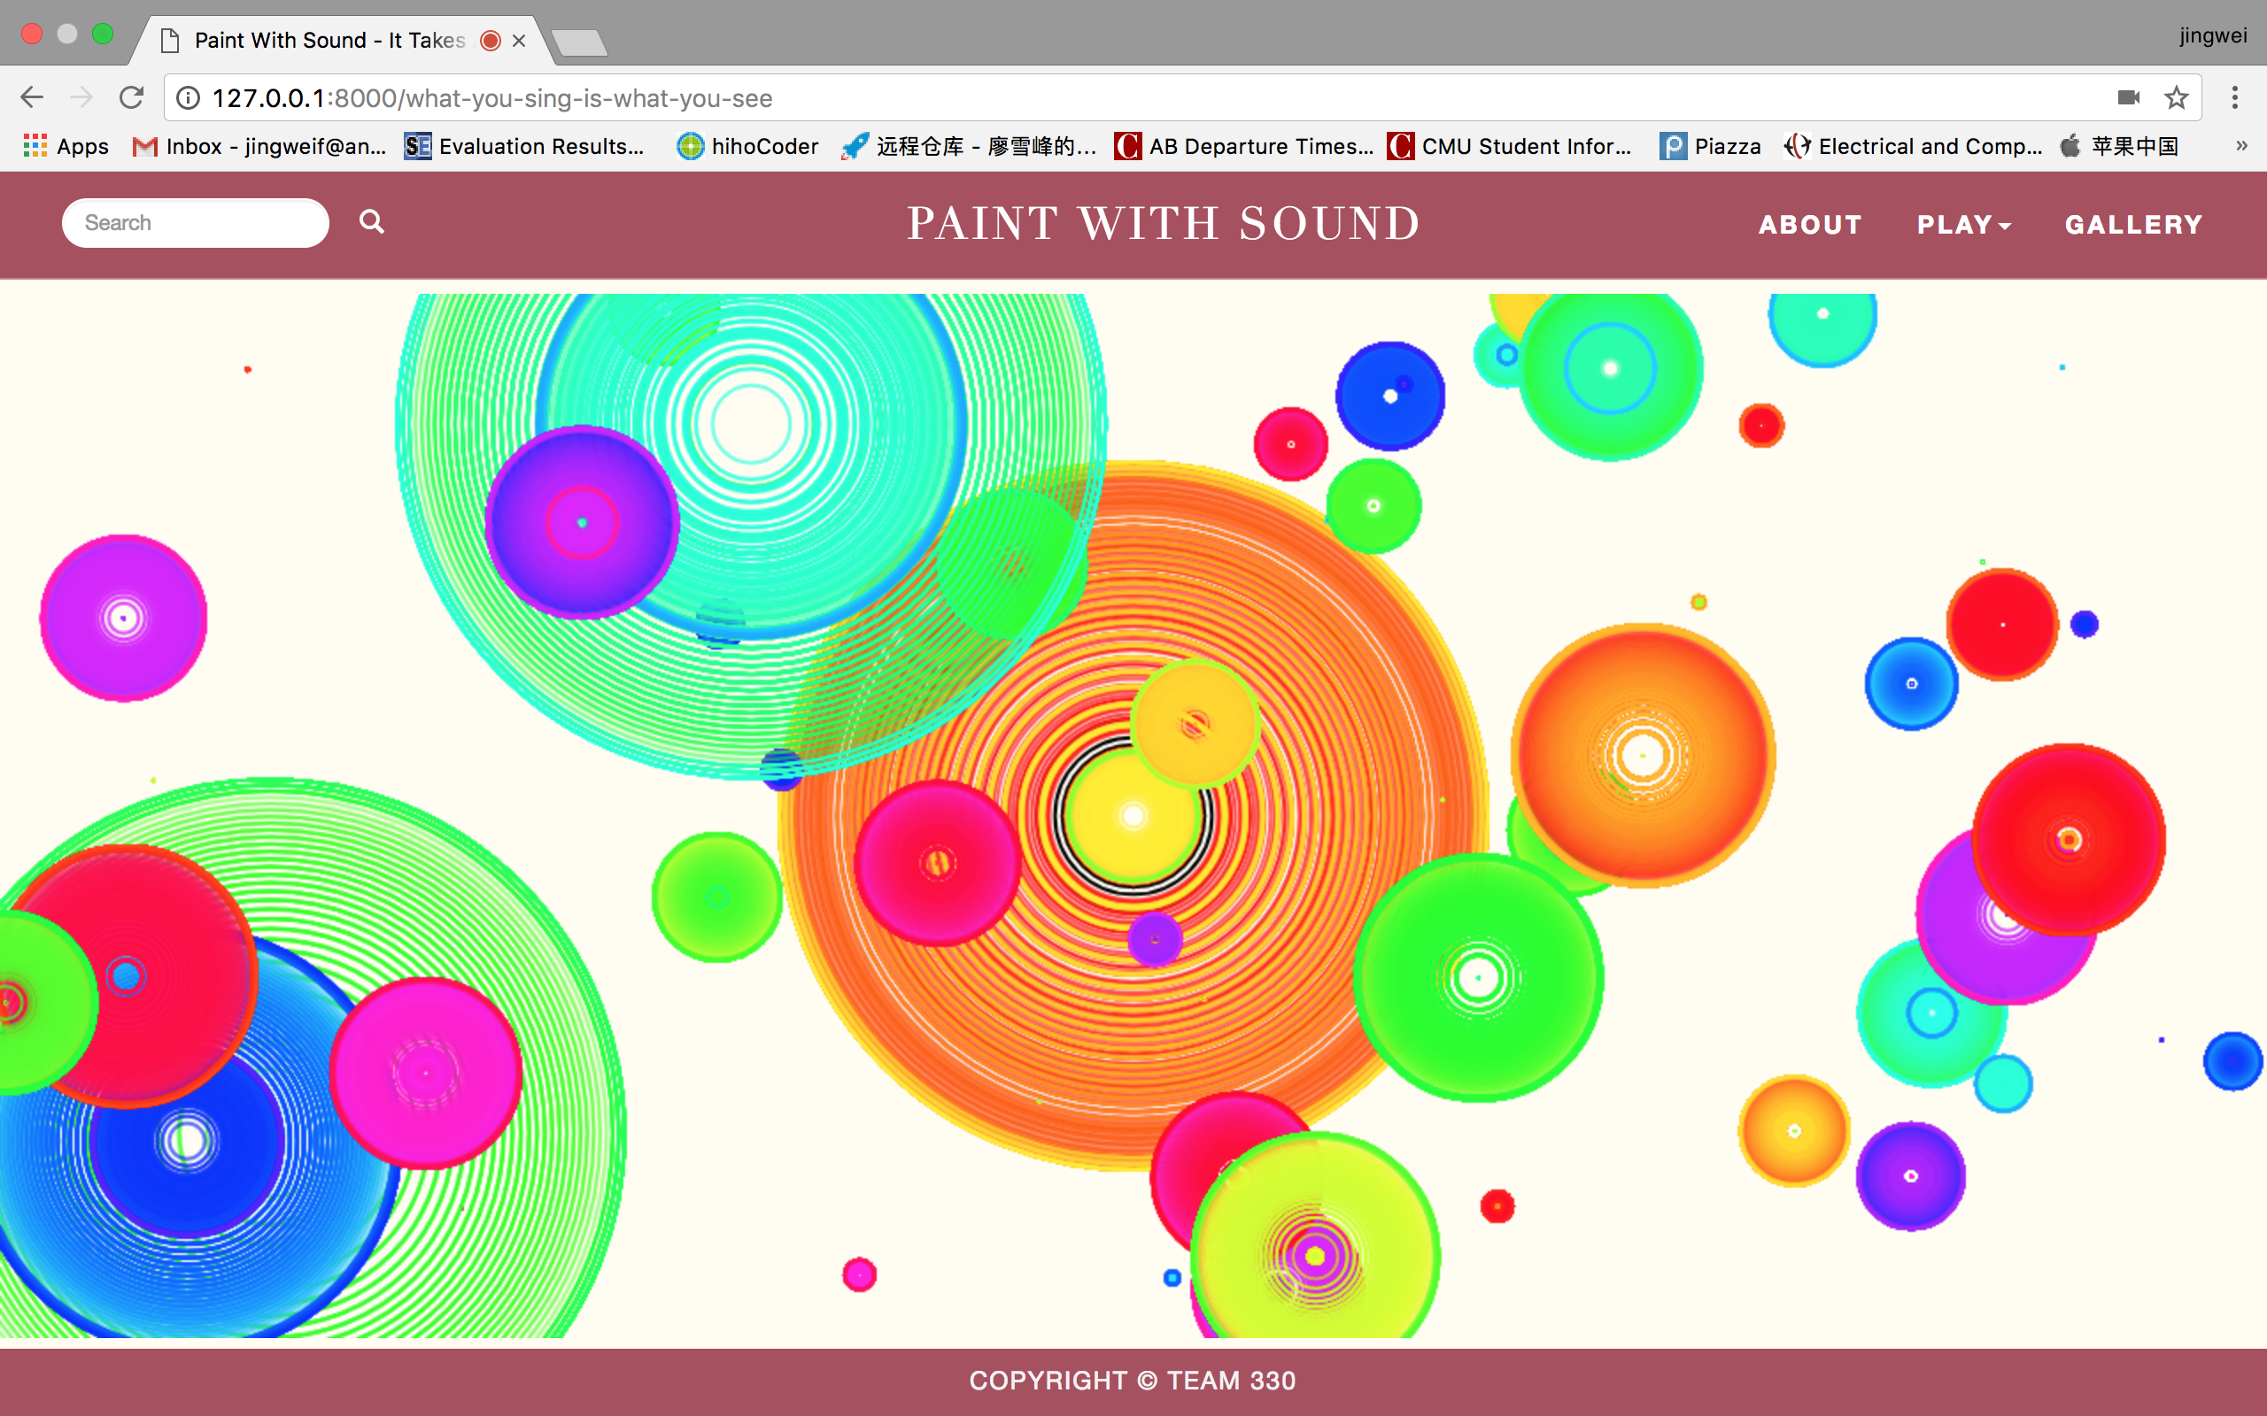
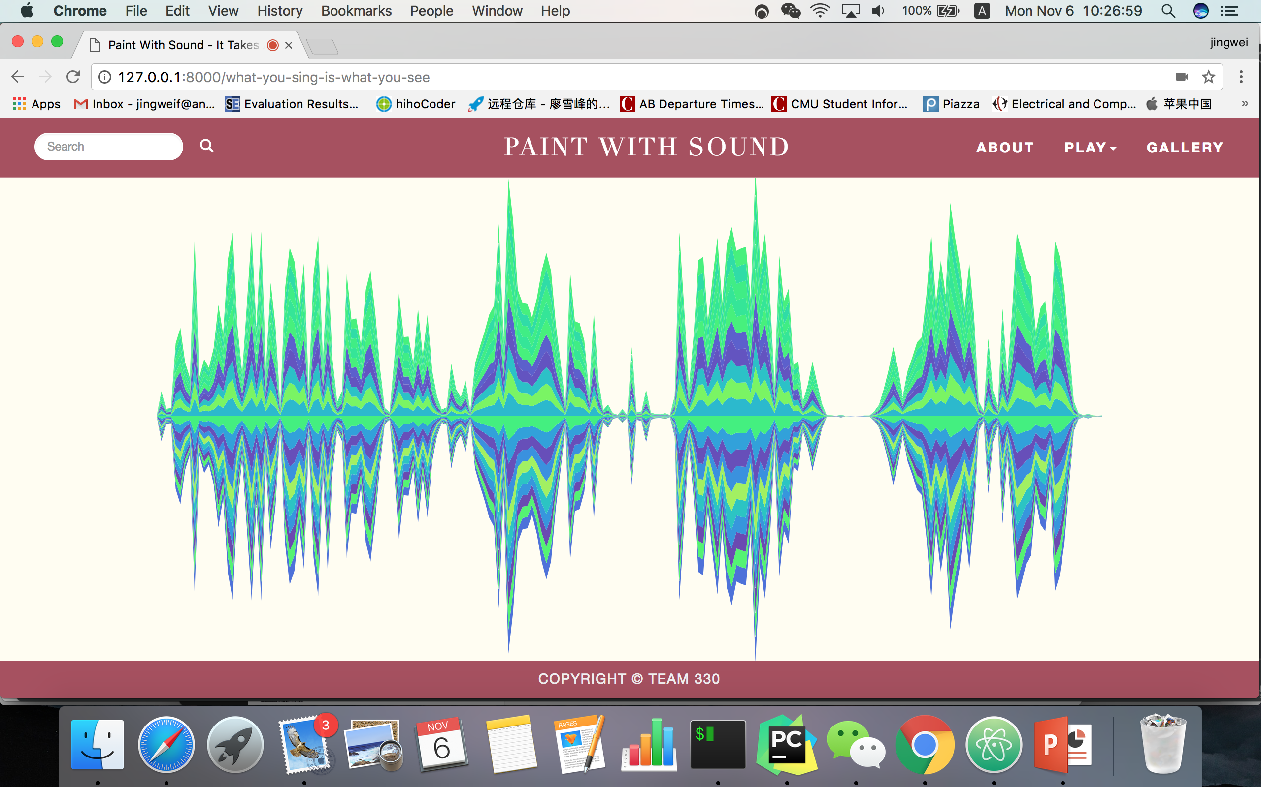
Demo Presentation
Notes:
Add a generated image here

Slide 11
Problem & Reflection in Sprint 1
Work left to be done:
We are kind of fall behind our original schedule.
Add more patterns for image generating.
Save image and audio for user.
For next sprint:
Fix the problems ASAP
Implement the second mode
Backlog can be divided more specifically

